Slide 1

Shri Vaishnav Vidyapeeth Vishwavidyalaya
Shri Vaishnav Institute of Information Technology
AUTOMATIC SUMMARIZATION OF USER REVIEWS
Under the Supervision of:
Prof. Sujit Badodia
Prof. Manorama Chouhan
Information Technology Department
PRESENTED BY:
Piyush Mali 19100BTIT06588
Raghav Sood 19100BTIT06595
Rishika Jain 19100BTIT06604

Slide 2
AUTOMATIC SUMMARIZATION
OF USER REVIEWS
PRESENTED TO:
Prof. Jitendra Sharma
Prof. Shrikant Telang
Prof. Aruna Patidar
Information Technology Department
PRESENTED BY:
Piyush Mali 19100BTIT06588
Raghav Sood 19100BTIT06595
Rishika Jain 19100BTIT06604

Slide 3
CONTENTS
Introduction
Use Case of Text Summarization
Problem Statement
Problem Domain
Literature Survey
Feasibility Study
Work Flow
Technology Used
Conclusion
References

Slide 4
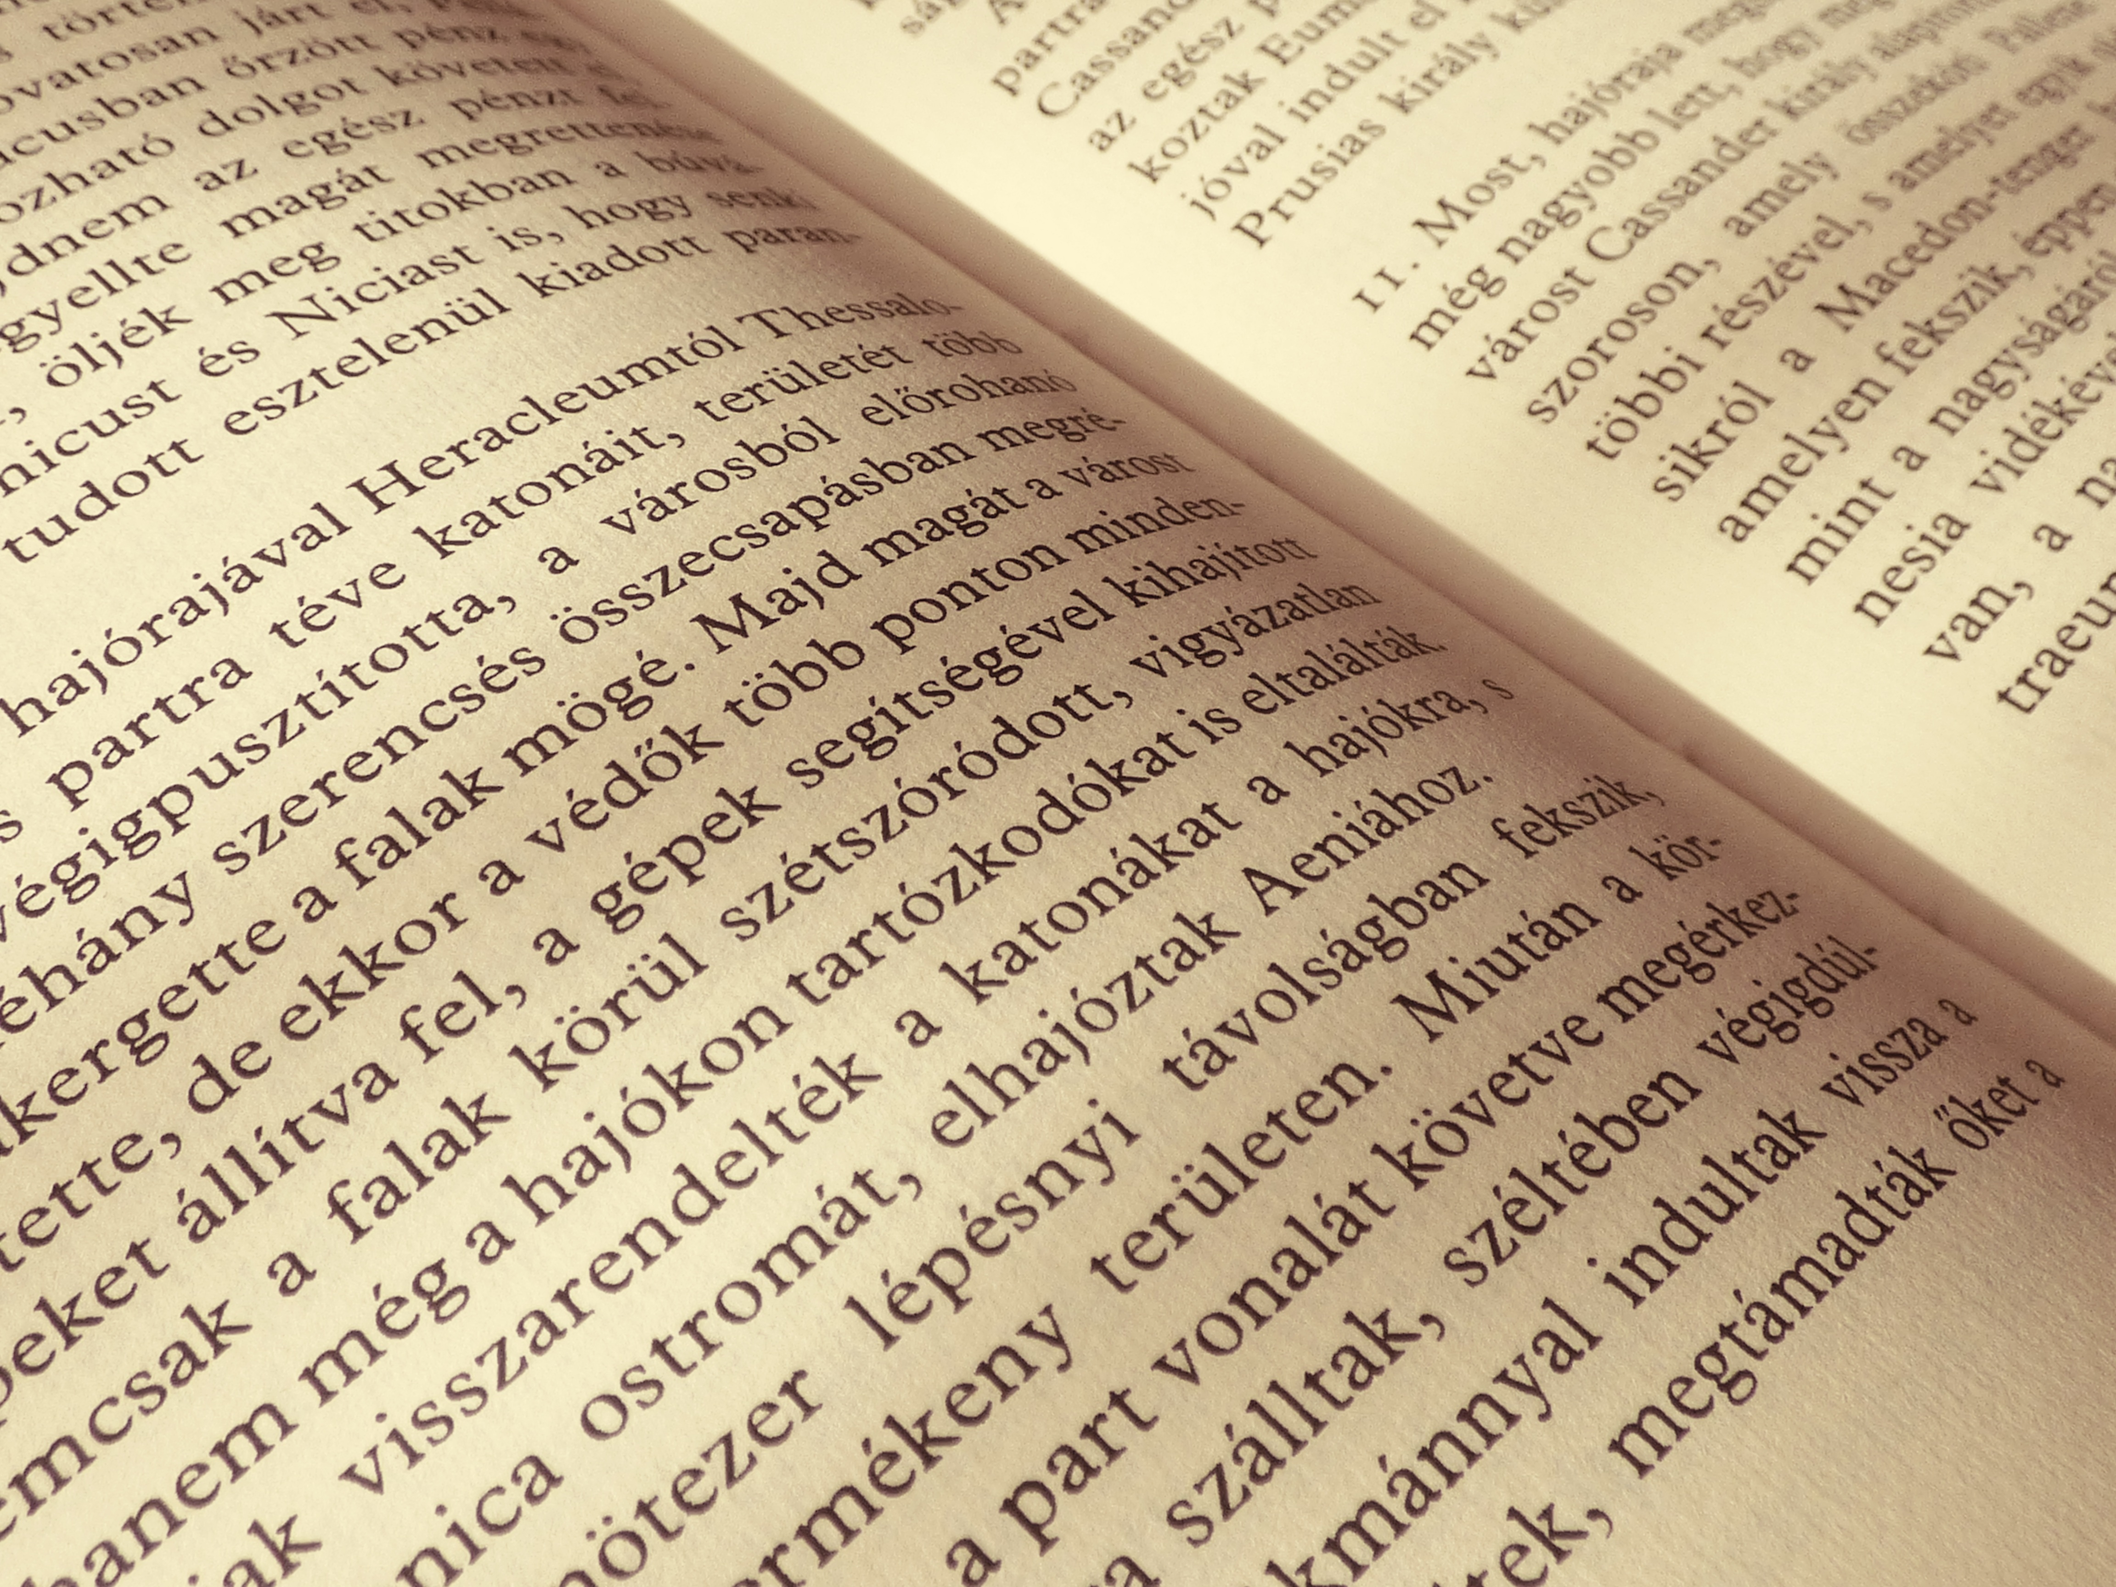
INTRODUCTION
What is Summary?
It conveys important information in the original text(s).
It is no longer than half of the original text(s) and usually significantly less than that.
Automatic Text Summarization:
Text summarization is the process of distilling the most important information from a source (or sources) to produce an abridged version for a particular user (or users) and task (or tasks).

Slide 5

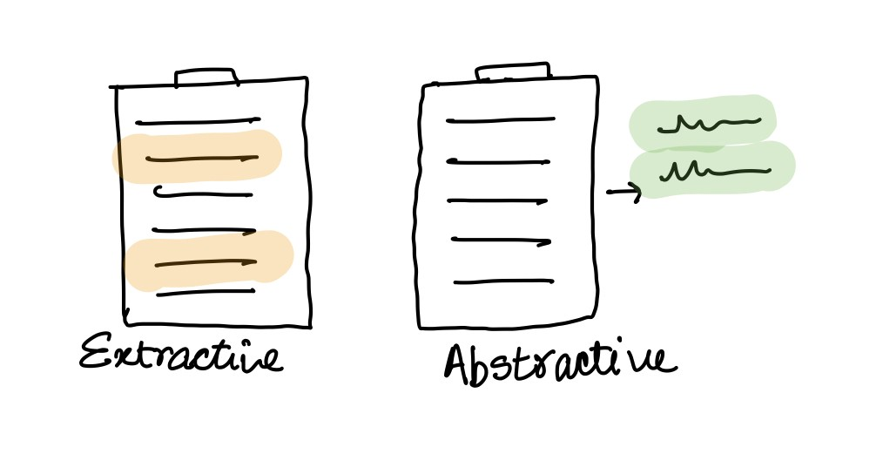




Text summarization can be done in two ways
Extractive text summarization:
Select Parts – Sentences – from the original text –works unsupervised.
So, identifying the right sentences for summarization is of utmost importance in an extractive method.
Abstractive text summarisation:
Creates novel sentences using NLG – works with Deep learning.
So it generates an entirely new summary.

Slide 6
USE CASE OF TEXT SUMMARIZATION
Newsletters: Summarization would allow organizations to further enrich newsletters with a stream of summaries (versus a list of links), which can be a particularly convenient format in mobile.
Financial research: Summarization systems tailored to financial documents like earning reports and financial news can help analysts quickly derive market signals from content.
Social media marketing: Companies producing long-form content, like whitepapers, e-books and blogs, might be able to leverage summarization to break down this content and make it sharable on social media sites like Twitter or Facebook. This would allow companies to further re-use existing content.
E-learning and Class assignments: Many teachers utilize case studies and news to frame their lectures. Summarization can help teachers more quickly update their content by producing summarized report.

Slide 7
PROBLEM STATEMENT
Objectives:
Study and Compare existing text summarization methods.
To identify gaps in existing tools used for Automatic text summarization.
Design and implement a tool or model for automatic summarization of user reviews.

Slide 8
PROBLEM DOMAIN
The problem is to define and build a model which could automatically summarize user reviews for a product from an e-commerce website using NLP (Natural Language Processing) techniques and also evaluate the accuracy of the summarization model built.
However, the difficulty lies in the processing of human language which makes NLP difficult. The rules that dictate the passing of information using natural language are not easy for a computer to understand.
Some of these rules can be high-leveled and abstract example when someone uses a sarcastic remark to pass information. On the other hand, some of these rules can be low-leveled.
For example, using the character “s” to signify the plurality of items. There are many other problems associated with the processing of the human language by machines.
There are no fixed and precise rules that can be taught to the machine due to the ambiguous nature of the human language, the ambiguity and imprecise characteristics of the natural languages are what make NLP difficult for machines to implement.

Slide 9
Literature survey
A survey of Automatic Text Summarization Progress, Process & Challenges (2021)
By M. F. Mridha, A. A. Lima, K. Nur, S. C. Das, M. Hasan and M. M. Kabir
In this they’ve done an analysis of all the methods of text summarization to date they’ve used 324 research papers did analysis.
In the paper they discuss the limitations and challenges of various algorithms and ATS methods.
In challenges they’ve talked about giving priority to producing robust summary and ATS should be made intelligent by integrated systems.
Automatic text summarization: A comprehensive survey, Expert Systems with Applications(2021)
By Wafaa S. El-Kassas, Cherif R. Salama, Ahmed A. Rafea, Hoda K. Mohamed
In this, they talked about various places where ATS can be used like multi-document user-specific summarization, query-based, domain-specific etc
Research community is focused on extractive summarization using different methods and techniques to achieve meaningful summaries as the abstractive approach is highly complex and extensive NLP.

Slide 10
Feasibility study
The Project" Automatic Summarization of User Reviews" aims to provide an efficient and enhanced summarization tool for the users that can be used to perform automatic text summarization of all the users to determine the reliability of a product based on the past experiences of the customers who have used the product previously.
Since there are a large number of reviews present for a product and a user does not have the time to go through all of them, our model will aim to summarize all the reviews and pick only the Top 10 (both negative and positive out of those.
This will help the user in making a faster decision. In this project, we'll tend to summarize the reviews posted by the users on the e-commerce giant Amazon for the mobile phones purchased by them through the website The dataset used will be Prompt cloud which contains approx. 4 Lakhs reviews.
We'll be analyzing our results based on certain metrics like Model Efficiency and Time Efficiency. The accuracy of the summarizer will also be evaluated.
The mixed Reviews present in the dataset will first be segregated into positive and negative and then a score will be given to each of those positive and negative reviews. The Top 10 reviews with the highest score will be presented to the user based on which a user will be able to conclude its analysis and make an informed decision.

Slide 11
WORKFLOW
Collection of Dataset
Calculation of polarity of sentences and giving them scores
TextRank algorithm to summarise the positive and negative sets
2
4
Pre-processing or cleaning of data.
Separation of data into positive and negative sets according to their score.
1
3
5

Slide 12
Technology used
Tech Stack
- Language: Python
- Libraries: NLTK, Textblob, Vader, NumPy, Pandas, Networkx
Algorithm used:
- TextRank: To Rank Sentences according to its importance in text, based on Google Page Rank Algorithm.
- Glove Model: To Create Word Embeddings. We've used Stanford's GloVe 100d word embeddings for our project.

Slide 13
CONCLUSION
As the Internet allows users to interact more, customer reviews posted on the Web have experienced significant growth in recent years. However, the large number of customer reviews posted on sites like Amazon.com make it difficult for marketers and business analysts to understand customer concerns. In this presentation, we describe an approach to automatically summarize customer reviews and present the preliminary results of our research on product reviews listed on Amazon.com. We believe our work will help improve the techniques and understanding of customer review summaries and will benefit online marketers, business intelligence, and business owners alike. Research in the field of text mining and e-commerce.

Slide 14
REFERENCES
M. F. Mridha, A. A. Lima, K. Nur, S.. Das, M. Hasan and M. M. Kabir, "A Survey of Automatic Text Summarization: Progress, Process and Challenges," in IEEE CAccess, volume 9, pp. 156043-156070, 2021, doi:10.1109/ACCESS.2021.3129786. (2021)
Wafaa S. El-Kassas, Cherif R. Salama, Ahmed A. Rafea, Hoda K. Mohamed,Automatic text summarization: A comprehensive survey, Expert Systems with Applications,Volume 165,113679 ISSN 0957-4174, https://doi.org/10.1016/j.eswa.2020.113679 (2021)
Kumar, Y., Kaur, K. & Kaur, S. Study of automatic text summarization approaches in different languages. ArtifIntell Rev 54, 5897–5929 https://doi.org/10.1007/s10462-021-09964-4 (2021)
Atif, Naomie and Yogan. P ,Genetic semantic Graph Approach for multi document abstractive Summarization. Fifth International Conference on Digital Information Processing and Communications (ICDIPC)(2015).
GloVe: Global Vectors for Word Representation: Jeffrey Pennington, Richard Socher, Christopher D. Manning https://nlp.stanford.edu/projects/glove/ (2014)

Slide 15

Thank You.
ANY QUERIES?

